Slide 1

NESTJS AND MIGRATING HR BACHEND TO NESTJS
Presenter: Huynh Gia Thien

Slide 2

Introduction
Feature overview
Sample code
Plan refactor HR backend to Nestjs

Slide 3
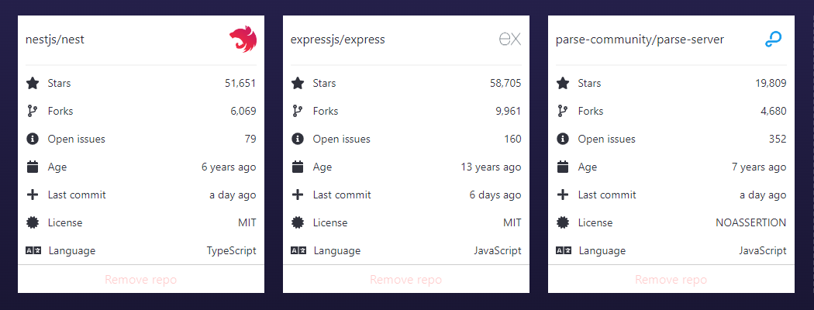
Introduction

Slide 4

Introduction

Slide 5

Introduction
Framework
Nest (NestJS) is a framework for building efficient, scalable Node.js server-side applications.
Open-source, extensible, versatile, progressive Node.js framework. Be influented by Angular (Dependency injection)
It use both Javascript and fully supports TypeScript.
Advantages
Highly testable, scalable, loosely coupled, Easy unit testing and easily maintainable application
Can build with Rest API, MVC, microservices, Websocket, scron job and more modules.
Database: MongoDB, MySQL, PostgreSQL.
Detailed and well-maintained documentation.
The structure is very simple

Slide 6
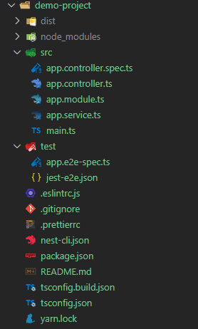
Introduction (Installation)
Install Nest CLI (Command Line Interface):
npm i -g @nestjs/cli
Create nestjs project:
nest new project-name

Slide 7
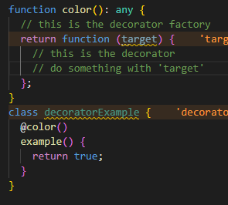
Feature overview
2.1 Decorator
A Decorator is a special kind of declaration that can be applied to classes, methods, accessor, property, or parameter.

Slide 8
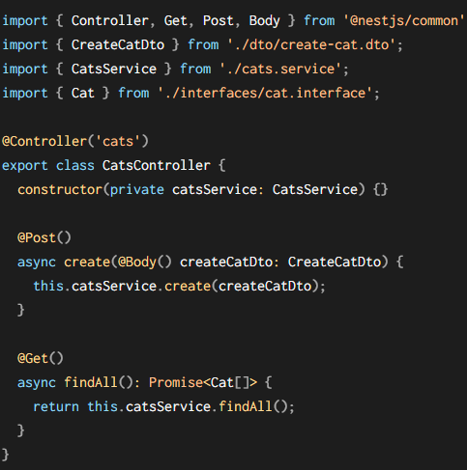
Feature overview
2.2 Controllers

Slide 9
Feature overview
2.3 Providers
Repositories
Factories
Helpers
Services
The main idea of a provider is that it can be injected as a dependency so can create various relationships.

Slide 10
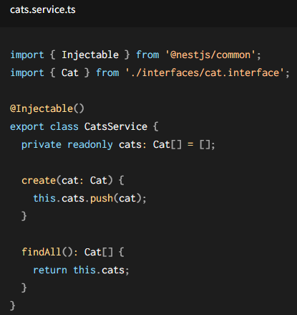
Feature overview
2.3 Services
Service will be responsible for data storage and retrieval and is designed to be used by the controller.

Slide 11
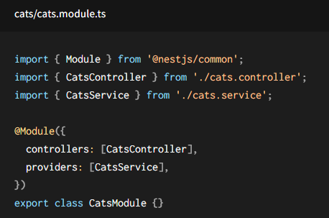
Feature overview
2.4 Modules
The @Module() decorator provides metadata that Nest makes use of to organize the application structure.

Slide 12
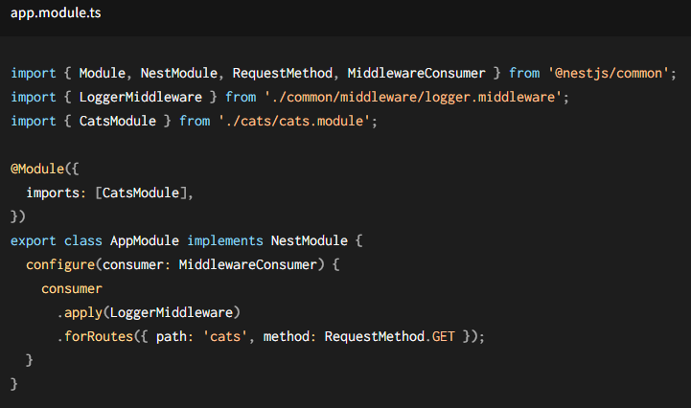
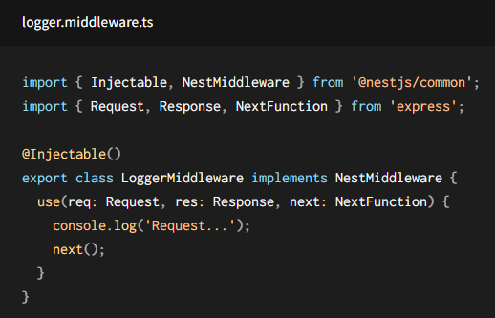
Feature overview
Middleware is a function which is called before the route handler.
Equivalent to express middleware.
Nest middleware in either a function, or in a class with an @Injectable() decorator.
2.5 Middleware
Advantages: Flexible application
Disadvantages: Since they are registered in the module, may not realize it applies to router when we are looking at its methods.

Slide 13
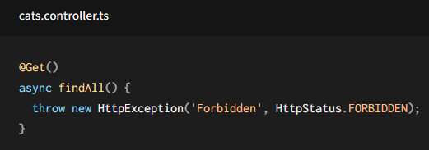
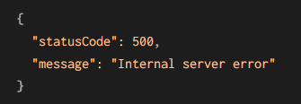
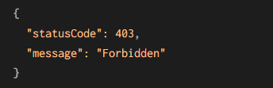
Feature overview
2.6 Exception filters
Exception filters this layer is responsible for processing all unhandled exceptions across an application.
It will handle all exceptions with HttpExceptions type

Slide 14
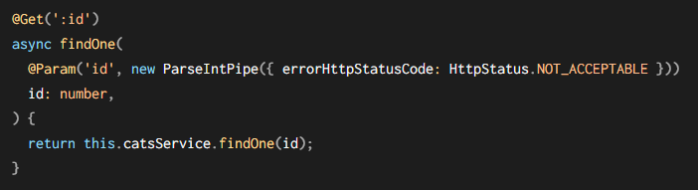
Feature overview
A pipe is a class annotated with the @Injectable() decorator, which implements the PipeTransform interface.
Pipes have two typical use cases: transformation and validation.
Pipe can use like @Decorator(), parameter & global.
2.7 Pipes

Slide 15
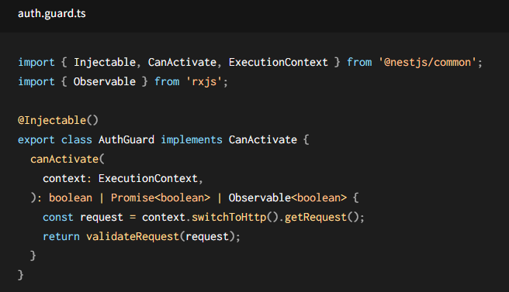
Feature overview
A pipe is a class annotated with the @Injectable() decorator, , which implements the CanActivate interface.
Guards have a single responsibility. Referred to as authorization.
Guards are executed after all middleware, but before any interceptor or pipe.
2.8 Guards

Slide 16
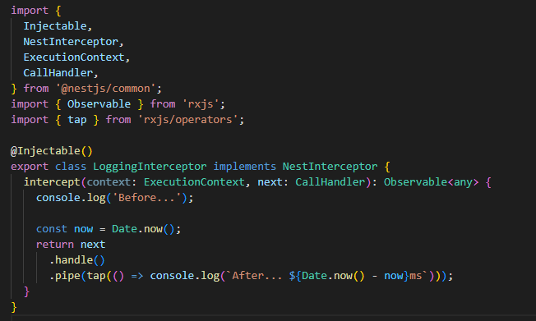
Feature overview
An interceptor is a class annotated with the @Injectable() decorator and implements the NestInterceptor interface.
It possible to:
bind extra logic before / after method execution
transform the result returned from a function
transform the exception thrown from a function
extend the basic function behavior
completely override a function depending on specific conditions (e.g., for caching purposes)
2.9 Interceptor

Slide 17
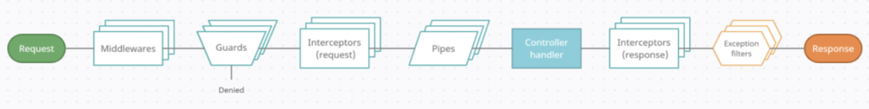
Feature overview

Slide 18
Sample code

Slide 19
Plan refactor HR backend to Nestjs
Different folder structure
Create new responsitory
Module feature relationship
Refector API follow by independent level

Slide 20


THANKS FOR WATCHING

